Slide 1

A Technical Seminar Presentation
on -
EXASCALE COMPUTING: ADVANCING PARALLELISM IN COMPUTATION
By-
Karanveer Singh (20WJ1A05C7)
GURU NANAK INSTITUTIONS TECHNICAL CAMPUS (AUTONOMOUS)

Slide 2
CONTENTS
Abstract
Introduction
Factors Driving Exascale Computing
Thermal Management
Necessities of Exascale Computing
ARM Based Processors
Exascale Computing and Big Data
The Challenges
Algorithmic Changes
Semiconductor Fabrication Advancement
Intel Monolithic Architecture
Conclusion

Slide 3
ABSTRACT
Embarking on the exascale computing journey signifies more than a mere increase in computational power; it's a pivotal evolution in computing architecture. This seminar explores the imminent shift towards exascale, characterized by a staggering increase in parallelism involving millions of processor cores working in symphony.
The ripple effects extend beyond raw processing power, prompting radical changes in hardware design, driven not only by technological aspirations but also by the pragmatic constraints of power consumption. Delving into the heart of this transformation, to examine the intricate interplay between hardware and software— from the intricacies of application codes to the orchestration of compilers, I/O, middleware, and related software tools.
As we navigate this uncharted territory, it becomes crucial to draw insights from past transitions, such as the journey from the megaflop to the present petaflop era. This retrospective lens allows us to glean valuable lessons, providing a foundation for understanding the challenges and opportunities on the road to exascale. Furthermore, we explore the readiness of advanced applications to fully harness the transformative potential of exascale computing.

Slide 4
INTRODUCTION
Exascale computing stands at the forefront of high-performance computing, representing a monumental leap in computational power. It refers to systems capable of performing a quintillion (10^18) calculations per second, known as an exaflop. Achieving exascale computing entails harnessing the power of millions of processing cores working in concert.
A FLOP (Floating Point Operation) is a basic arithmetic operation involving floating-point numbers, typically addition, subtraction, multiplication, or division. In the context of computing performance, FLOPs are used as a measure of computational speed, indicating the number of floating-point operations a processor can perform in a given amount of time.
To put this into perspective, consider that a standard laptop operates at the level of gigaflops (10^9 floating-point operations per second), and current supercomputers typically operate in the petaflop (10^15) range. Exascale computing represents a thousandfold increase in performance over current supercomputers, enabling researchers to tackle complex problems at an unprecedented scale and speed.

Slide 5
FACTORS DRIVING EXASCALE
COMPUTING
Increased Core Counts: Enhanced parallelism through higher core counts enables more simultaneous computations, crucial for exascale performance.
ARM-Based Architectures: ARM processors offer energy-efficient performance, suitable for scaling to exascale levels.
System-on-Chip (SoC) Designs: Integration of multiple components into a single chip reduces latency and power consumption, vital for exascale systems.
Advanced Memory Technologies: High Bandwidth Memory (HBM), Non-Volatile Memory Express (NVMe), and 3D-stacked memory enhance data access speeds and efficiency.
High-Bandwidth Interconnects: Technologies like Infinity Fabric provide fast data transfer between components, essential for exascale systems.
GPU Computing: GPU architectures, such as CUDA and Tensor Cores, offer massive parallel processing capabilities, aiding exascale performance.
Energy Efficiency: Focus on compute power per watt ensures sustainable and cost-effective exascale systems.

Slide 6
Heat Management: Techniques like vapor chambers, phase change cooling, liquid cooling, graphite sheets, and liquid metals manage heat dissipation efficiently, crucial for exascale systems.
Low Latency: Minimizing latency in data transfer and computation is essential for real-time processing in exascale systems.
Advanced Processor Designs: Technologies like AMD's HEDT and Intel's performance hybrid designs optimize performance and energy efficiency for exascale computing.
Shrinking Process Nodes: Smaller process nodes offer improved performance and efficiency, benefiting exascale systems.
RISC Architecture: RISC (Reduced Instruction Set Computer) designs, as seen in Apple M series and Qualcomm Snapdragon Elite X, optimize performance for specific tasks, aiding exascale computing.
Clock Speed Optimization: Increasing base and boost clock speeds, including overclocking, boosts computational performance, useful for exascale computing.
Software Optimization: Tools like Intel Turbo Boost and MSI Afterburner optimize CPU parameters and GPU performance, enhancing exascale computing capabilities.
Unified Memory: Unified memory architectures and high-frequency DDR memory enhance data access speeds and efficiency in exascale systems.

Slide 7
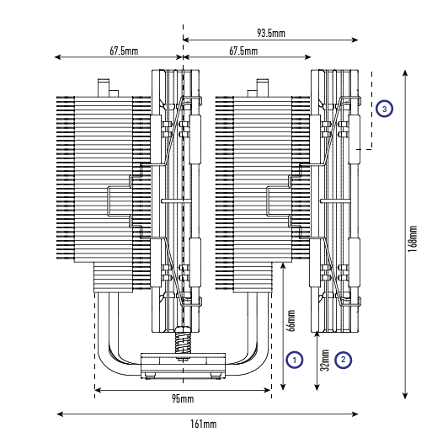
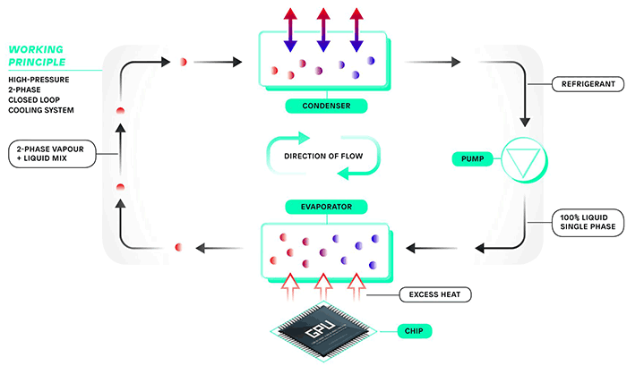
THERMAL MANAGEMENT

Slide 8
NECESSITIES OF EXASCALE
COMPUTING
Advancing Scientific Discovery: Exascale computing enables simulations and modeling at unprecedented scales, allowing scientists to explore complex phenomena in physics, chemistry, biology, and other fields. This leads to new discoveries and insights that would be otherwise impossible.
Accelerating Engineering Design and Innovation: Exascale computing enables engineers to simulate and optimize designs with high fidelity, reducing the need for physical prototypes and accelerating the development of new technologies, products, and infrastructure.
Enhancing National Security and Defense: Exascale computing is critical for national security and defense applications, including simulations for nuclear weapons, cybersecurity, and defense system optimizations, ensuring the safety and security of nations.
Transforming Healthcare and Medicine: Exascale computing enables personalized medicine through advanced simulations and data analytics, leading to more effective treatments, drug discoveries, and healthcare innovations.

Slide 9
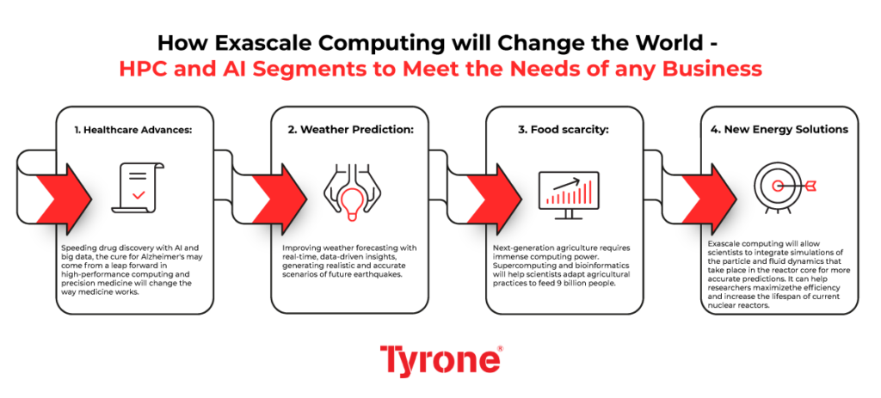
Improving Climate and Environmental Modeling: Exascale computing enhances our ability to model climate change, natural disasters, and environmental processes, aiding in mitigation strategies and policy decisions for a sustainable future.
Advancing Space Exploration and Astronomy: Exascale computing supports complex simulations for space missions, astronomical observations, and cosmological simulations, expanding our understanding of the universe and enabling breakthroughs in space exploration.
Fostering Innovation and Economic Growth: Exascale computing drives innovation across industries, fostering economic growth through the development of new technologies, industries, and markets.

Slide 10
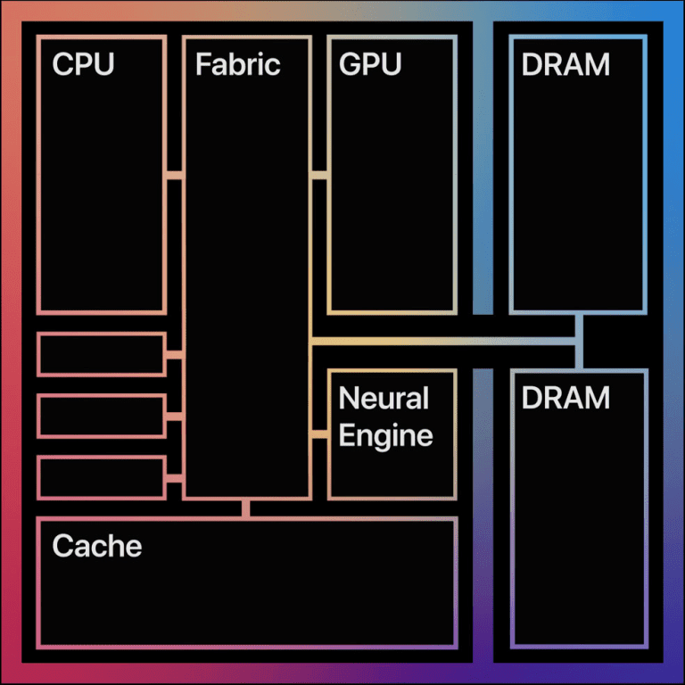
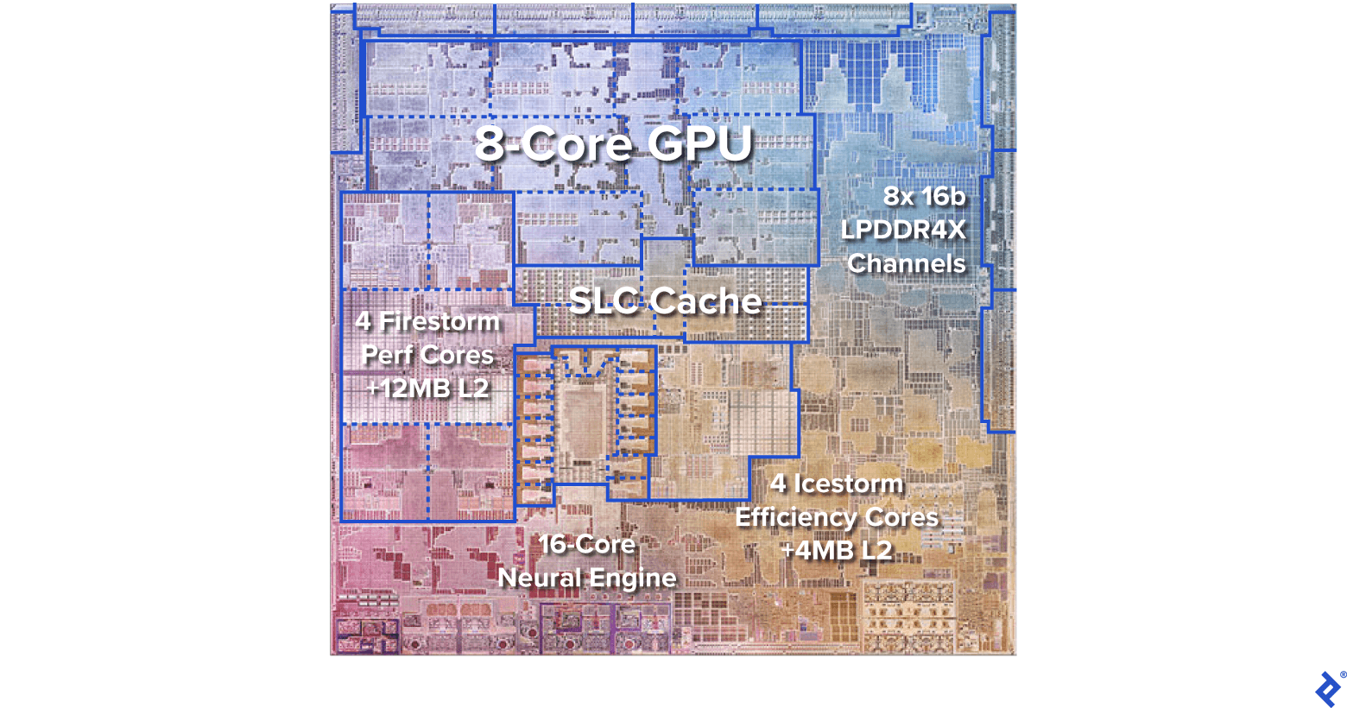
ARM BASED PROCESSORS

Slide 11
EXASCALE COMPUTING AND BIG DATA
Enhanced Data Processing Speed: Exascale computing enables big data analytics to process vast amounts of data at unprecedented speeds, allowing for real-time analysis and decision-making. This speed advantage allows organizations to extract insights from data more quickly and efficiently than ever before.
Scalability for Massive Data Sets: Exascale computing provides the scalability needed to handle massive data sets, allowing organizations to analyze and derive insights from data that were previously too large to process. This scalability ensures that big data analytics can keep pace with the ever-increasing volume, velocity, and variety of data generated in today's digital world.
Complex Data Analysis: Exascale computing enables big data analytics to perform highly complex analyses on large and diverse data sets. This includes advanced machine learning algorithms, deep learning models, and other AI techniques that can uncover intricate patterns and insights from data, leading to more accurate predictions and decision-making.

Slide 12
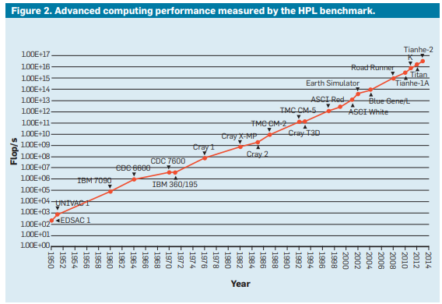

Slide 13
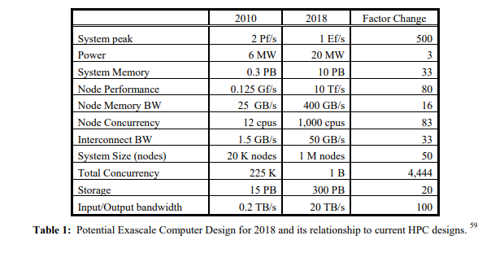
THE CHALLENGES
Scaling Challenges
Major R&D Progress
Power Challenge
System Memory Challenge
System Resiliency Challenge
Fault Tolerance
Programming Models
I/O Devices
Tools
Thermal Management
Silicon Fabrication

Slide 14
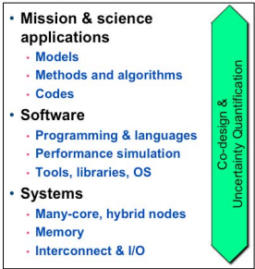
ALGORITHMIC CHANGES
New multicore-friendly and multicore-aware algorithms
Adaptive Response to Load Imbalance
Multiple precision algorithms/software
Scheduling and memory management for
heterogeneity and scale
Auto Tuning
Communication avoiding i.e, independence
It is important for all of computer science to design algorithms that communicate as little as possible, ideally attaining lower bounds on the amount of communication required.

Slide 15
SEMICONDUCTOR FABRICATION ADVANCEMENT
Reduction in Process Nodes: One of the key challenges in semiconductor manufacturing is the continual shrinking of process nodes to achieve higher transistor density and performance. As process nodes become smaller, challenges such as increased leakage currents, variability, and manufacturing complexity arise, requiring innovative solutions to maintain the pace of Moore's Law.
Materials and Manufacturing Techniques: Developing new materials and manufacturing techniques is essential to overcome the physical limits of silicon-based transistors. This includes exploring alternative materials, such as III-V semiconductors and 2D materials like graphene, as well as advanced manufacturing processes like extreme ultraviolet lithography (EUV) to achieve finer feature sizes.

Slide 16
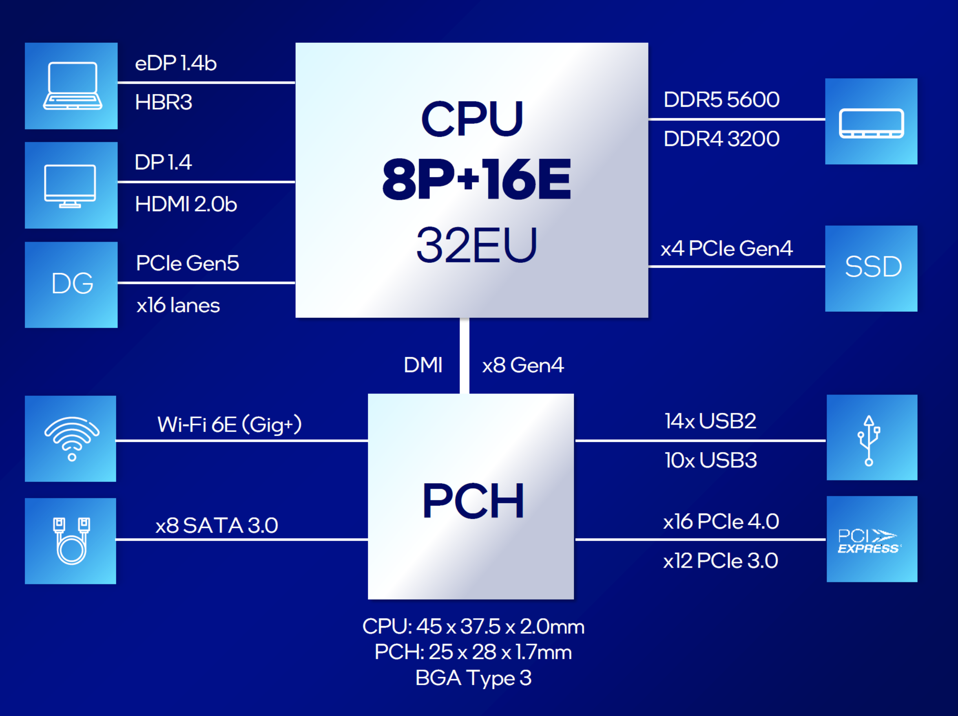
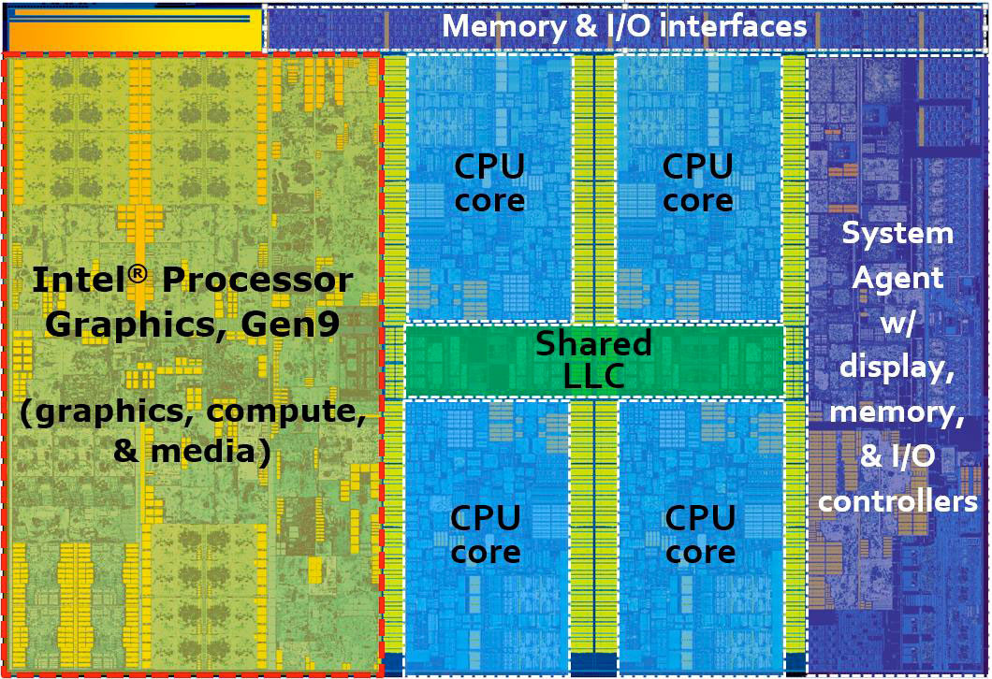
INTEL MONOLITHIC ARCHITECTURE

Slide 17
CONCLUSION
It's clear that both big data analytics and exascale computing are integral to computing's future, and neither should be neglected in favor of the other. Investment in algorithms, software, and applications is as vital as in hardware. The global IT landscape is evolving, emphasizing low-power mobile devices, cloud services, and data analytics. Collaboration between private and global research entities is essential for developing exascale computing and data analytics capabilities.
In conclusion, advanced computing presents both great opportunities and challenges. To realize scientific discoveries through computational science and data analytics, sustained investment in high-performance computing infrastructure is crucial for the future of computing.

Slide 18
Q&A

Slide 19
THANK YOU
THANK YOU

